Slide 1

Bank loan Status Prediction
Team Name :: G5
Divya
Naveen kumar
Harshith
Anish
Shilpa Kate
Mentor Name:-
Parth
Kavipriya
Date :- 5 March 2021

Slide 2
Business Problem:
Enhancement in the banking sector lots of people are applying for bank loans but the bank has its limited assets which it has to grant to limited people only, so finding out to whom the loan can be granted which will be a safer option for the bank is a typical process.
It’s not at all easy to get a loan from the bank. Getting a loan approved requires a complex mix of factors not the least of which is a steady income! So this ML project aims to create a model that will classify how much loan the user can obtain based on various factors such as the user’s marital status, income, education, employment prospects, number of dependents, etc. The dataset attached provides details about all these factors which can then be used to create an ML model that demonstrates the amount of loan that can be approved.
Objective:
To predict the impact of the incident raised by the customer.

Slide 3
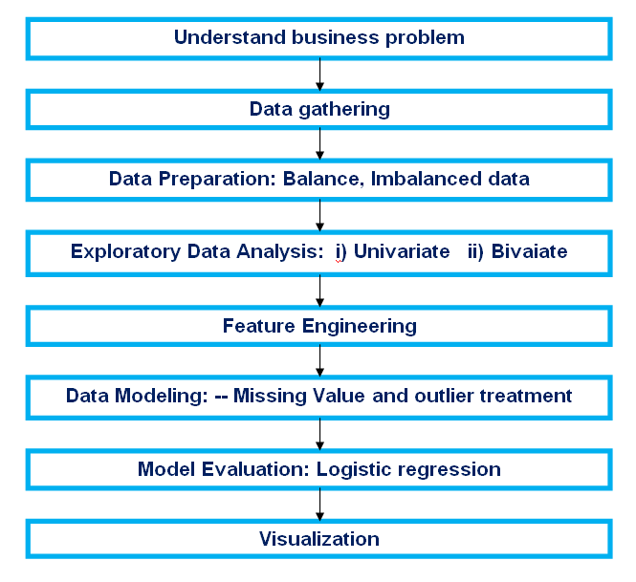
Project Architecture / Project Flow

Slide 4
Data set details
1) Train Dataset
Loan_ID | Gender | Married | Dependents | Education | Self_Employed | ApplicantIncome | CoapplicantIncome | LoanAmount | Loan_Amount_Term | Credit_History | Property_Area | Loan_Status
LP001002 | Male | No | 0 | Graduate | No | 5849 | 0 |  | 360 | 1 | Urban | Y
LP001003 | Male | Yes | 1 | Graduate | No | 4583 | 1508 | 128 | 360 | 1 | Rural | N
LP001005 | Male | Yes | 0 | Graduate | Yes | 3000 | 0 | 66 | 360 | 1 | Urban | Y
LP001006 | Male | Yes | 0 | Not Graduate | No | 2583 | 2358 | 120 | 360 | 1 | Urban | Y
LP001008 | Male | No | 0 | Graduate | No | 6000 | 0 | 141 | 360 | 1 | Urban | Y
LP001011 | Male | Yes | 2 | Graduate | Yes | 5417 | 4196 | 267 | 360 | 1 | Urban | Y
LP001013 | Male | Yes | 0 | Not Graduate | No | 2333 | 1516 | 95 | 360 | 1 | Urban | Y
LP001014 | Male | Yes | 3+ | Graduate | No | 3036 | 2504 | 158 | 360 | 0 | Semiurban | N
LP001018 | Male | Yes | 2 | Graduate | No | 4006 | 1526 | 168 | 360 | 1 | Urban | Y
Rows | 614
Columns | 13
Independent variable | 12
Target variable | 1
From the dataset we can infer that :-
1.Out of 614 applicants, 422(68.72%) has availed loans.
2.Most of the applicants are from Semi-Urban area.

Slide 5
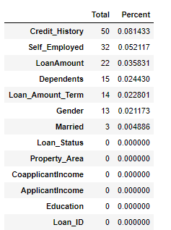
Data set details
1) Train Dataset
We can see there are three formats of data types:
Object : Object format means variables are categorical. Categorical variables in our dataset are: Loan_ID, Gender, Married, Dependents, Education, Self_Employed, Property_Area, Loan_Status.
Int64 : It represents the integer variables. ApplicantIncome is of this format.
Float64 : It represents the variable which have some decimal values involved. They are also numerical.
Missing Values
Imputation Methods for missing values:-
For numerical variables: mean or median
For categorical variables: mode

Slide 6
Major observation from the data
80% of applicants in the dataset are male
65% of the applicants in the dataset are married.
15% of applicants in the dataset are self-employed.
Most of the applicants don't have any dependents.
80% of the applicants are Graduate.
Most of the applicants are from the Semiurban area.
Most of the data in the distribution of applicant income are towards the left which means it is not normally distributed.
The boxplot confirms the presence of a lot of outliers/extreme values.
Higher number of graduates with very high incomes, which are appearing to be outliers.
The proportion of loans getting approved in the semi-urban area is higher as compared to that in rural or urban areas.
We can observe Proportion of loans getting approved for applicants having low Total_Income < applicants with Average, High & Very High Income.
ApplicantIncome & Loan Amount, CreditHistory & Loan_Status, LoanAmount is also correlated with CoapplicantIncome.

Slide 7
Data set details
2) Test Dataset
Loan_ID | Gender | Married | Dependents | Education | Self_Employed | ApplicantIncome | CoapplicantIncome | LoanAmount | Loan_Amount_Term | Credit_History | Property_Area
LP001015 | Male | Yes | 0 | Graduate | No | 5720 | 0 | 110 | 360 | 1 | Urban
LP001022 | Male | Yes | 1 | Graduate | No | 3076 | 1500 | 126 | 360 | 1 | Urban
LP001031 | Male | Yes | 2 | Graduate | No | 5000 | 1800 | 208 | 360 | 1 | Urban
LP001035 | Male | Yes | 2 | Graduate | No | 2340 | 2546 | 100 | 360 |  | Urban
LP001051 | Male | No | 0 | Not Graduate | No | 3276 | 0 | 78 | 360 | 1 | Urban
LP001054 | Male | Yes | 0 | Not Graduate | Yes | 2165 | 3422 | 152 | 360 | 1 | Urban
LP001055 | Female | No | 1 | Not Graduate | No | 2226 | 0 | 59 | 360 | 1 | Semiurban
LP001056 | Male | Yes | 2 | Not Graduate | No | 3881 | 0 | 147 | 360 | 0 | Rural
In the test dataset we have similar features as the train dataset except for the Loan_Status.
We can predict the Loan_Status using the model built using the train data.

Slide 8
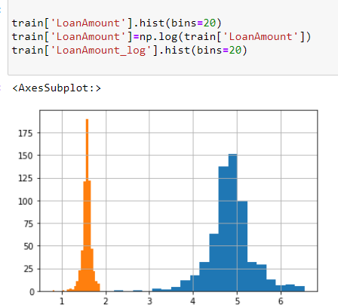
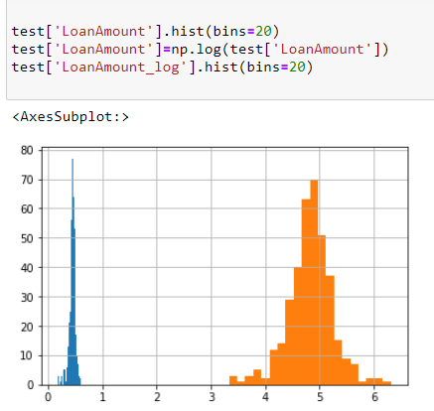
Outlier Treatment
lets first consider how to remove outliers of LoanAmount.
#bulk of the data in the loan amount is at the left and the right tail is longer. This is called right skewness.
#we can remove the skewness is by doing the log transformation
Train Data
Test Data

Slide 9
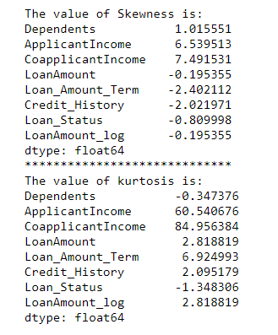
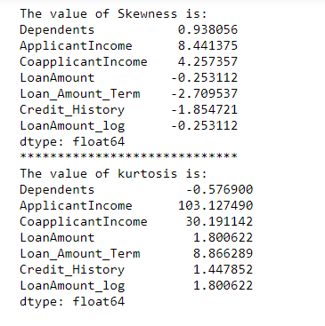
Skewness and Kurtosis
Train Data
Test Data

Slide 10
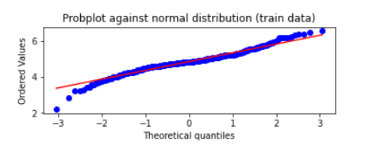
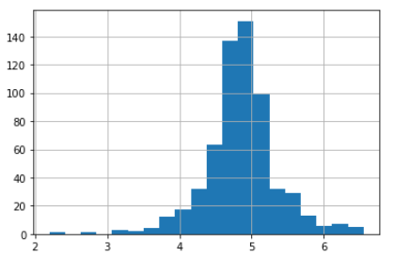
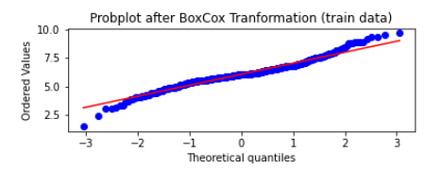
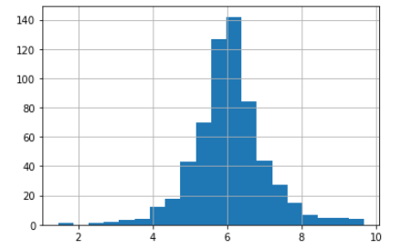
Remove Skewness
Power transformation : LoanAmount(Train data)

Slide 11
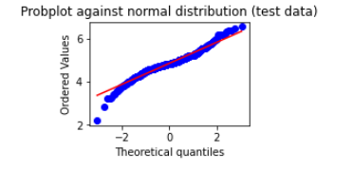
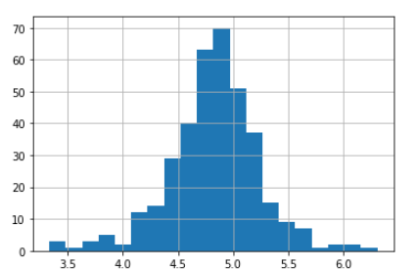
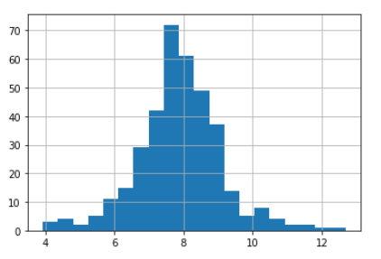
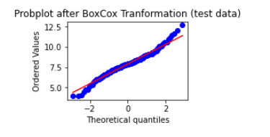
Remove Skewness
Power transformation : LoanAmount(Test data)

Slide 12
Class –Balance and Imbalance data
Random Undersampling
Before undersampling: Counter({1: 293, 0: 136})
After undersampling: Counter({0: 136, 1: 136})
ROC AUC score for undersampled data: 0.4749446290143965
Oversampling with SMOTE
Before oversampling: Counter({1: 293, 0: 136})
After oversampling: Counter({1: 293, 0: 293})
ROC AUC score for oversampled SMOTE data: 0.4562569213732004

Slide 13
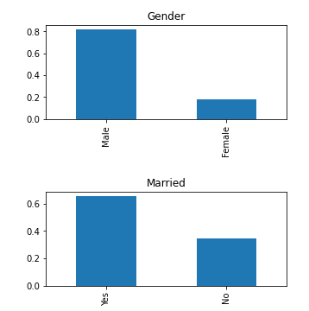
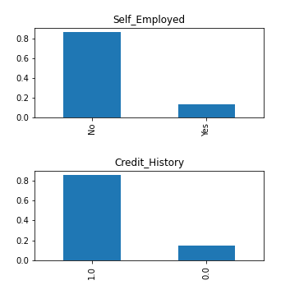
EDA :- Univariate Analysis
Independent Variable (Categorical)
It can be inferred from the above bar plots that:
80% of applicants in the dataset are male
65% of the applicants in the dataset are married.
15% of applicants in the dataset are self-employed.
85% of applicants have repaid their doubts.

Slide 14
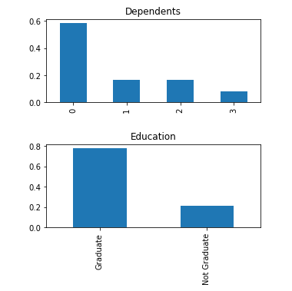
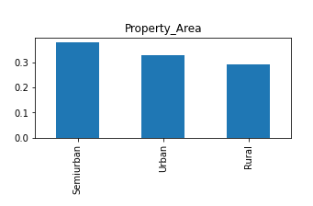
EDA :- Univariate Analysis
Independent Variable (Ordinal)
It can be inferred from the above bar plots that:
Most of the applicants don't have any dependents.
80% of the applicants are Graduate.
Most of the applicants are from the Semiurban area.

Slide 15
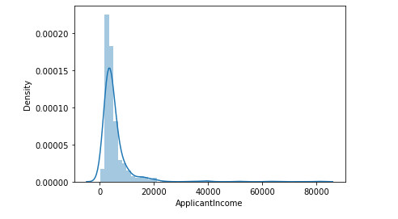
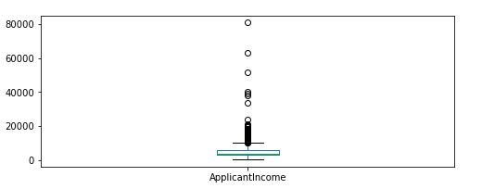
EDA :- Univariate Analysis
Independent Variable (Numerical):- Applicant Income
It can be inferred from the above bar plots that:
*Most of the data in the distribution of applicant income are towards the left which means it is not normally distributed.
*The boxplot confirms the presence of a lot of outliers/extreme values.
*Part of this can be driven by the fact that we are looking at people with different education levels. Let us segregate them by Education..

Slide 16
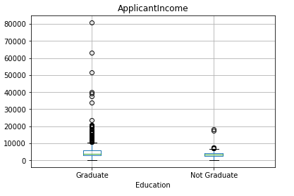
EDA :- Univariate Analysis
Applicant Income By Education
It can be inferred that:
Higher number of graduates with very high incomes, which are appearing to be outliers.

Slide 17
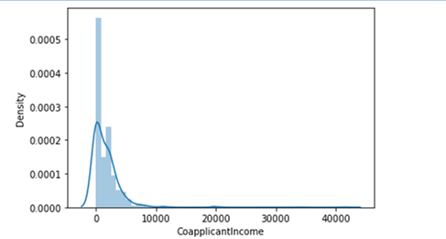
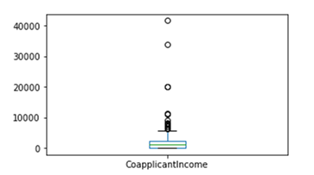
EDA :- Univariate Analysis
Independent Variable (Numerical):- Coapplicantincome
It can be inferred that:
The majority of co-applicants income ranges from 0 to 5000. We also see a lot of outliers in the applicant's income and it is not normally distributed.

Slide 18
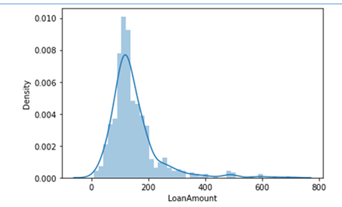
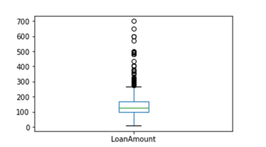
EDA :- Univariate Analysis
Independent Variable (Numerical):- LoanAmount
It can be inferred that:
lot of outliers in this variable and the distribution is fairly normal.

Slide 19
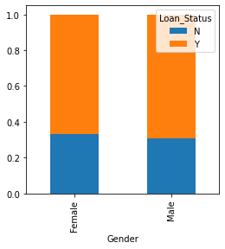
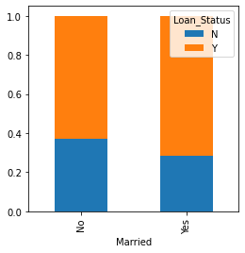
EDA :- Bivariate Analysis
Categorical Independent Variable vs Target Variable
Gender vs Loan Status Married vs Loan Status
It can be inferred that:
The proportion of male and female applicants is more or less the same for both approved and unapproved loans.
The proportion of married applicants is higher for approved loans

Slide 20
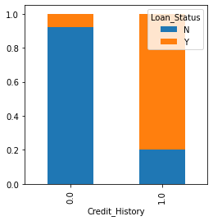
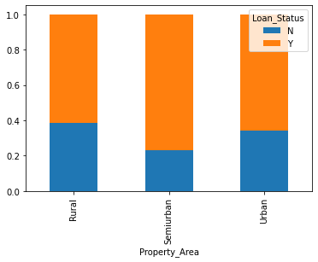
EDA :- Bivariate Analysis
Categorical Independent Variable vs Target Variable
Credit History vs Loan status Property area vs Loan Status
It can be inferred that:
It seems people with a credit history as 1 have get their loans approved.
The proportion of loans getting approved in the semi-urban area is higher as compared to that in rural or urban areas.

Slide 21
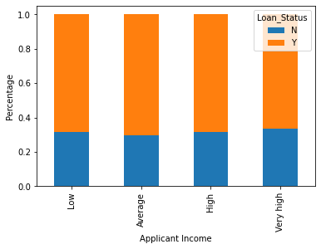
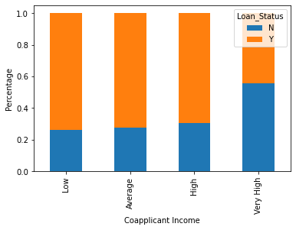
EDA :- Bivariate Analysis
Numerical Independent Variable vs Target Variable
Applicant Income vs Loan Status Co-Applicant Income vs Loan Status
It can be inferred that:
Applicant's income does not affect the chances of loan approval.
The assumption that “if the applicant's income is high the chances of loan approval will also be high" is wrong
.Also we can infer that there is no relation for Co-applicants Income with Loan Status

Slide 22
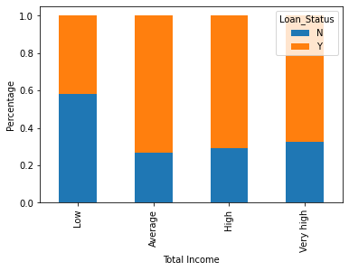
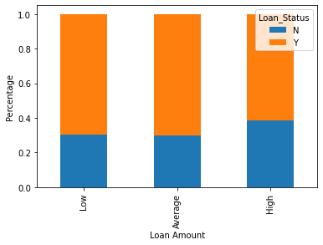
EDA :- Bivariate Analysis
Numerical Independent Variable vs Target Variable
Total Income vs Loan Status Loan Amount vs Loan Status
It can be inferred that:
Proportion of loans getting approved for applicants having low Total_Income < applicants with Average, High & Very High Income.
.Proportion of approved loans is higher for Low and Average Loan Amount as compared to that of High Loan Amount which supports our hypothesis in which we considered that the chances of loan approval will be high when the loan amount is less.

Slide 23
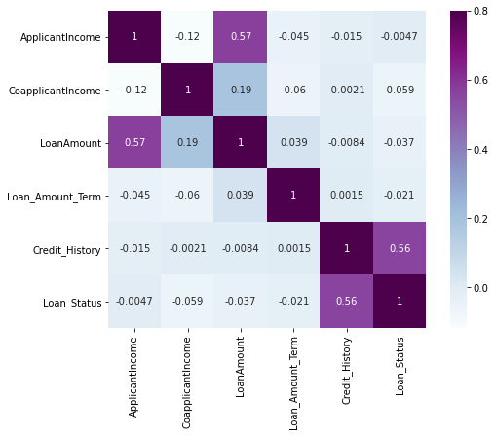
EDA :- Heat Map Analysis
It can be inferred that:
Loan Status is correlated mainly with Credit History only.

Slide 24
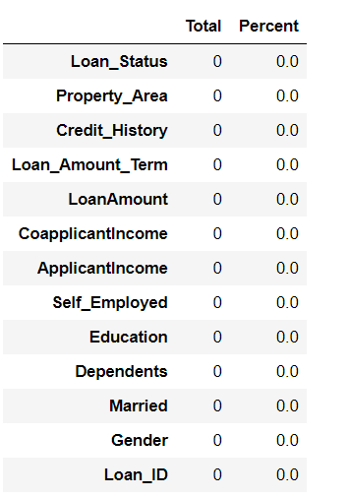
EDA :- Missing value imputation
Here missing values in Gender, Married, Dependents, Self_Employed, LoanAmount, Loan_Amount_Term, and Credit_History
Methods to fill the missing values:
For numerical variables: imputation using mean or median
Since Loan Amount has outliers instead of mean we can use median
For categorical variables: imputation using mode
Missing Values before Imputation
Missing Values after Imputation

Slide 25
Feature Engineering
From domain knowledge, we get new features that might affect the target variable. We will create the following three new features:
Total Income — As discussed during bivariate analysis we will combine the Applicant Income and Co-applicant Income. If the total income is high, the chances of loan approval might also be high.
train['Total_Income']=train['ApplicantIncome']+train['CoapplicantIncome']
test['Total_Income']=test['ApplicantIncome']+test['CoapplicantIncome']
EMI — EMI is the monthly amount to be paid by the applicant to repay the loan. The idea behind making this variable is that people who have high EMI’s might find it difficult to pay back the loan. We can calculate the EMI by taking the ratio of the loan amount with respect to the loan amount term.
train['EMI']=train['LoanAmount']/train['Loan_Amount_Term']
test['EMI']=test['LoanAmount']/test['Loan_Amount_Term']
Balance Income — This is the income left after the EMI has been paid. The idea behind creating this variable is that if this value is high, the chances are high that a person will repay the loan and hence increasing the chances of loan approval
train['Balance Income'] = train['Total_Income']-(train['EMI']*1000)
test['Balance Income'] = test['Total_Income']-(test['EMI']*1000)

Slide 26
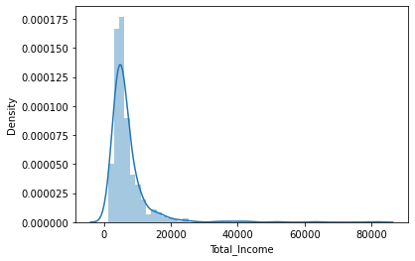
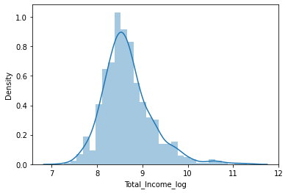
Feature Engineering
Plot of Total Income and Log of Total Income
Total Income Log of Total Income
From the plot of Total Income we can see the plot is right skewed which appears to be outliers. But since there will be some applicants with high income, we cannot consider them as outliers.
Hence we will apply Log Transformation to Total Income to reduce the skewness.
After applying Log Transformation we can see we are able ton avoid the effect of skewness.

Slide 27
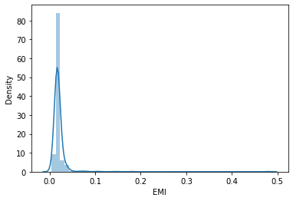
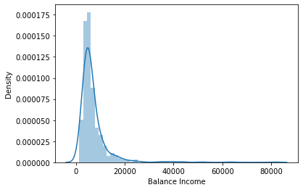
Feature Engineering
EMI Plot
Balance Income
From the EMI and Balance Amount plots we can infer that the mean of both are almost near to zero. But both of them appears to have a positive skewness which will not affect our calculations since they are derived variables from Total Income.

Slide 28
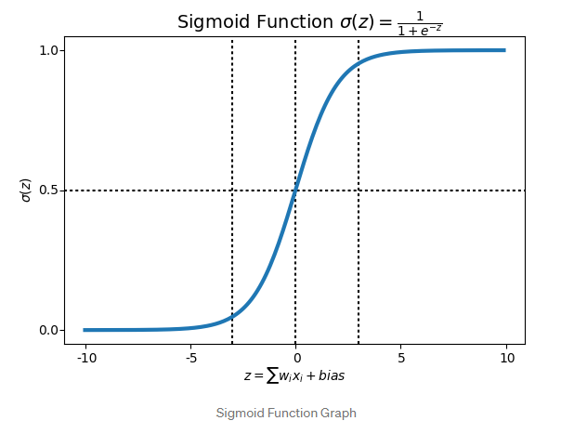
Model Building- Part 1
Logistic Regression
Logistic Regression is a Classification Algorithm.
Logistic Regression which is used for predicting binary outcome.
It is used to predict a binary outcome (1 / 0, Yes / No, True / False) given a set of independent variables.
Logistic regression is an estimation of Logit function. The logit function is simply a log of odds in favor of the event.
This function creates an S-shaped curve with the probability estimate, which is very similar to the required stepwise function
Mean Validation Accuracy = 79.45%

Slide 29
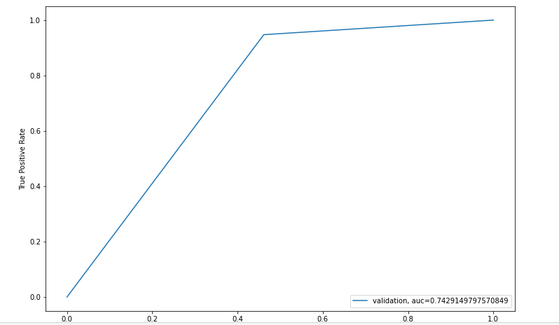
Model Building
Mean Validation Accuracy: %f 0.8324324324324325
Log_loss: 5.787682

Slide 30
Model Building :-Part II
K-Fold Cross Validation
Cross-validation is primarily used in applied machine learning to estimate the skill of a machine learning model on unseen data.
K-fold cross validation is performed as per the following steps:
Partition the original training data set into k equal subsets. Each subset is called a fold. Let the folds be named as f₁, f₂, …, f_{k} .
For i = 1 to i = k
Keep the fold f_{i} as Validation set and keep all the remaining k-1 folds in the Cross validation training set.
Train your machine learning model using the cross validation training set and calculate the accuracy of your model by validating the predicted results against the validation set.
Estimate the accuracy of your machine learning model by averaging the accuracies derived in all the k cases of cross validation.
In the k-fold cross validation method, all the entries in the original training data set are used for both training as well as validation. Also, each entry is used for validation just once.

Slide 31
Model Building :-Part II
Logistic Regression using stratified k-folds cross-validation
1 of kfold 5
accuracy_score 0.8130081300813008
2 of kfold 5
accuracy_score 0.7723577235772358
3 of kfold 5
accuracy_score 0.7804878048780488
4 of kfold 5
accuracy_score 0.7804878048780488
5 of kfold 5
accuracy_score 0.7295081967213115
Mean Validation Accuracy 0.7751699320271891

Slide 32
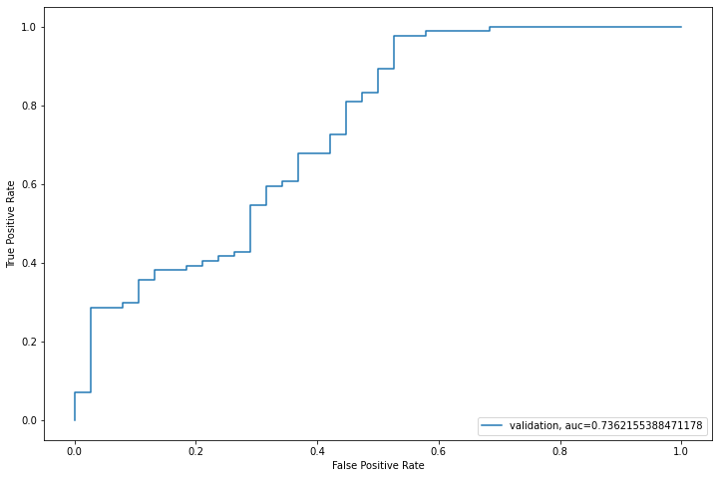
Model Building
Logistic Regression using stratified k-folds cross-validation
Receiver Operating Characteristics Curve
From ROC Curve, Area Under the Curve(AUC) value = 0.7362
That means we have an accuracy of 73.62% for our model.

Slide 33
Model Building
Decision Tree
1 of kfold 5
accuracy_score 0.7804878048780488
2 of kfold 5
accuracy_score 0.7886178861788617
3 of kfold 5
accuracy_score 0.7235772357723578
4 of kfold 5
accuracy_score 0.7479674796747967
5 of kfold 5
accuracy_score 0.6721311475409836
Mean Validation Accuracy 0.7425563108090099

Slide 34
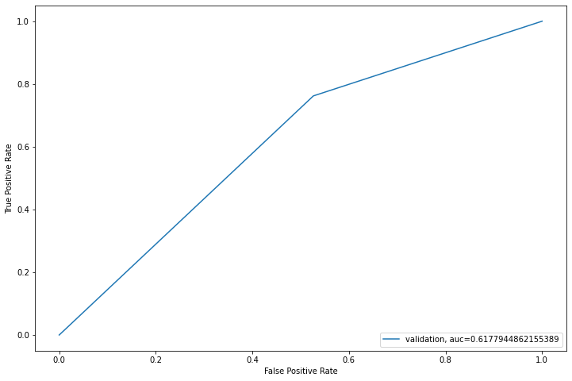
Model Building
Decision Tree
Receiver Operating Characteristics Curve
From ROC Curve Area Under Curve(AUC)= 61.77%

Slide 35
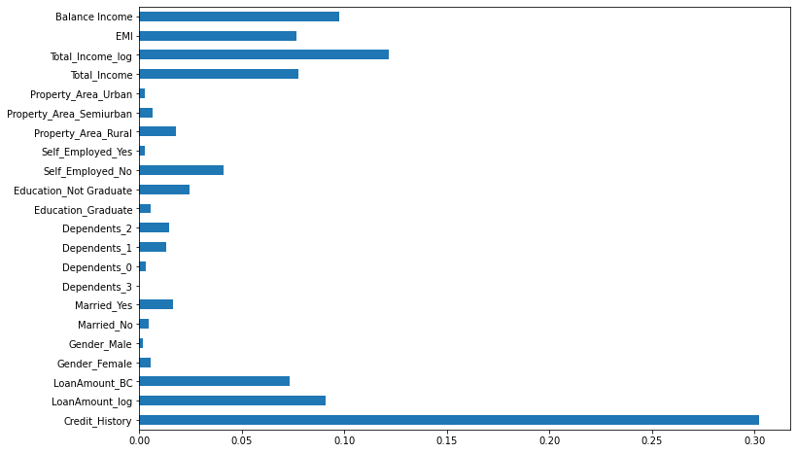
Model Building
Decision Tree
Feature Importance Plot
From the plot we can infer that Credit History is having highest importance while predicting the Loan Status. After that Total Income, Balance Income, EMI, Property Area and Self Employed Status have the importance in the respective order.

Slide 36
Model Building
Random Forest
1 of kfold 5
accuracy_score 0.8373983739837398
2 of kfold 5
accuracy_score 0.8211382113821138
3 of kfold 5
accuracy_score 0.8048780487804879
4 of kfold 5
accuracy_score 0.8048780487804879
5 of kfold 5
accuracy_score 0.7786885245901639
Mean Validation Accuracy 0.8093962415033987

Slide 37
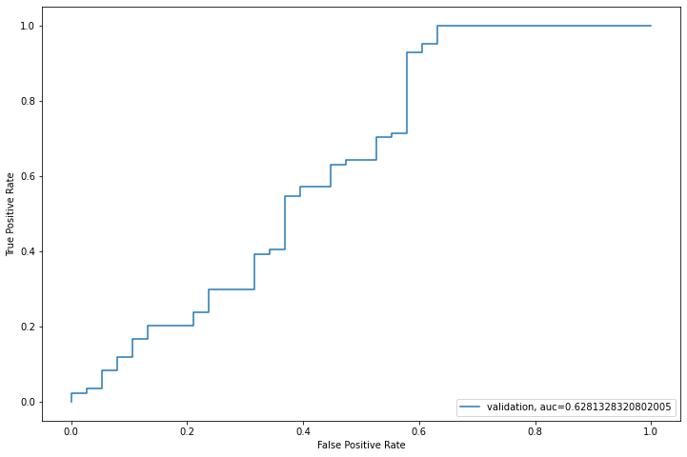
Model Building
Random Forest
Receiver Operating Characteristics Curve
From ROC Curve Area Under Curve(AUC)= 62.81%

Slide 38
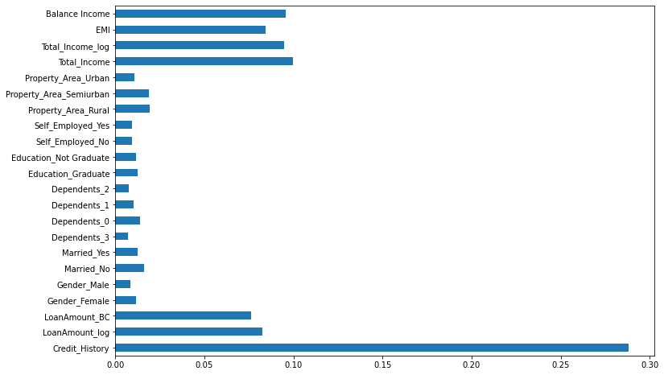
Model Building
Random Forest
Feature Importance Plot
From the plot we can infer that Credit History is having highest importance while predicting the Loan Status. After that Total Income, Balance Income, EMI, Property Area and Self Employed Status have the importance in the respective order.

Slide 39
Model Building
XGBoost
1 of kfold 5
accuracy_score 0.7886178861788617
2 of kfold 5
accuracy_score 0.7642276422764228
3 of kfold 5
accuracy_score 0.7886178861788617
4 of kfold 5
accuracy_score 0.7479674796747967
5 of kfold 5
accuracy_score 0.7622950819672131
Mean Validation Accuracy 0.7703451952552312

Slide 40

Model Building
XGBoost
Receiver Operating Characteristics Curve
From ROC Curve Area Under Curve(AUC)= 65.08%

Slide 41
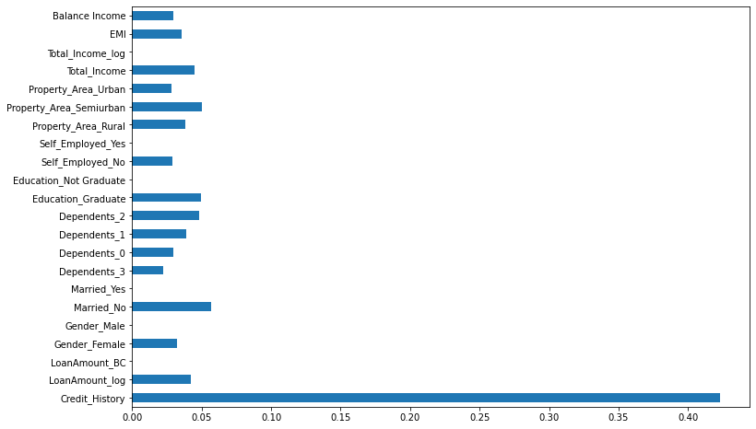
Model Building
XGBoost
Feature Importance Plot
From the plot we can infer that Credit History is having highest importance while predicting the Loan Status. After that Total Income, Balance Income, EMI, Property Area and Self Employed Status have the importance in the respective order.

Slide 42
Model Evaluation
Accuracy :- It is the ratio of number of correct predictions to the total number of input samples.
2. Log Loss:-
It has no upper bound and it exists on the range [0, ∞).
Log Loss nearer to 0 indicates higher accuracy, whereas if the Log Loss is away from 0 then it indicates lower accuracy.
3. AUC measures:-
How well a model is able to distinguish between classes.
AUC has a range of [0, 1]. The greater the value, the better is the performance of our model.

Slide 43
Model Evaluation
Algorithm | Mean Validation accuracy score | log_loss | AUC
Logistic Regression | 0.8324324324324325 | 5.787682 | 0.7429149797570849
Logistic Regression With K fold | 0.7751699320271891 | 9.342607 | 0.6835839598997494
Decision Tree | 0.7425563108090099 | 11.324320 | 0.6177944862155389
Random Forest | 0.8093962415033987 | 7.643985 | 0.6281328320802005
XGBOOST | 0.7703451952552312 | 8.210181 | 0.6508458646616542

Slide 44
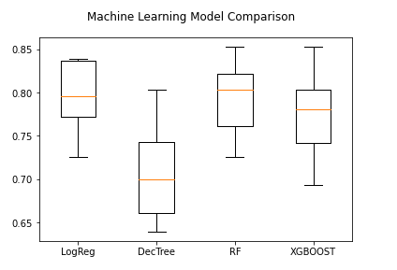
Model Evaluation
LogReg Mean=0.796563 STD=0.037769
DecTree Mean=0.703728 STD=0.050691
RF Mean=0.794976 STD=0.038921
XGBOOST Mean=0.773823 STD=0.043419

Slide 45
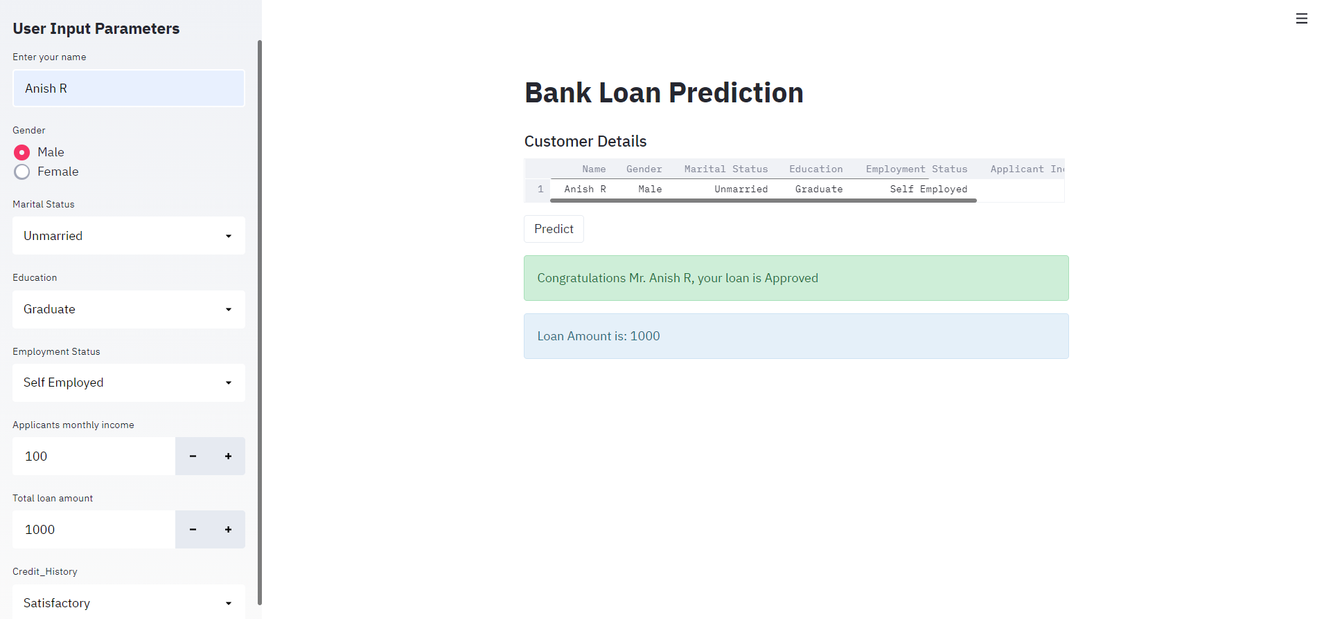
Model Deployment

Slide 46
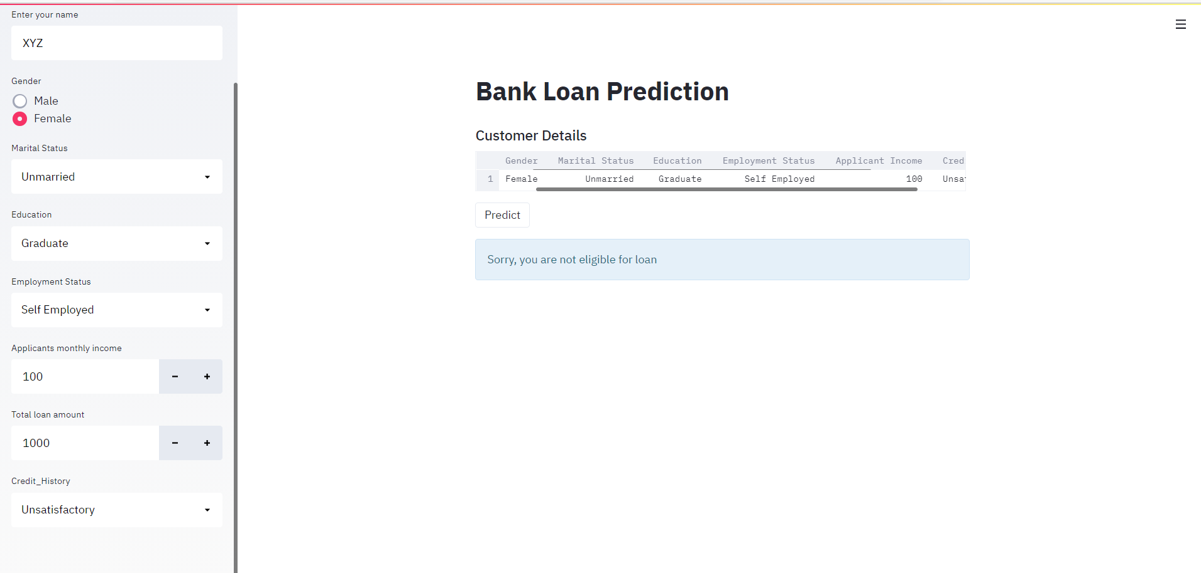
Model Deployment

Slide 47
Thank you

